Slide 1
Summer Training
2/C Winter Intersessional Brief
Class of 2025
Summer Training Department
LT Hayes Friddle (‘15)
1/C Training Officer
Notes:
Give quick intro and Bio

Slide 2
Key Takeaways
Standard Summer Training = 1 Fleet Cruise, 1 PTE, & 1 Block of Leave during the three PRIMARY Blocks (USNA Policy)
At least 1 Fleet Cruise is required for graduation (OPNAV Policy)
3rd and 4th events shall be done in lieu of leave
    0-Block utilized to ensure MIDN receive a full leave block who otherwise would not receive one due to MANDATED training. (i.e. NAAA blockers)
    Min 14 days of leave / Max 35 days, exceptions approved by DANT
Keep MIDS profile up to date (contact info/passport/CAC) - WILL AFFECT CRUISE ASSIGNMENT
Planning on full summer, but remain flexible - training schedules are likely to change. (i.e., buy refundable tickets & time to do vouchers on return)
Summer Training Travel Office location is 4-1
This brief will be posted on the Summer Training Intranet Site

Slide 3
Roles and Responsibilities
MIDN: Input summer preferences
CO/SEL: Assist MIDN in resolving schedule conflicts and ensuring leave requirements are met
Class Training Officers: Create MIDN summer schedules based on preferences, OOM, and Program Manager by-name requests
Assignments released 08 MAR
Notes:
‹#›
COs and SELs represent your best interest to the Class Training Officers. They are your primary point of contact with regarding to summer training assignment. They’re like your CO and XO in the fleet, working with BUPERS to mesh your desires with the needs or limitations of the service.
Class Training Officers are your Summer Training Detailers. Similar to detailers at BUPERS, they know what the fleet and program managers have to offer, they know who has requested you by name, and they know the training requirements you must fulfill. They’ll work with your COs and SELs to meet your desires to the best of their ability.
There are many others that have a hand in the summer training assignment process: Program Managers, Internship Sponsors, Athletic Department, Academic Department, Brigade Medical just to name a few. The Class Training Officers in the Training Department work with all of them behind the scenes.

Slide 4
Timeline
08 Jan: Reform Brief and PTE Fair (1130-1200 & 1445-1545 in Alumni Lobby)
16 - 30 Jan: Midshipmen enter preferences in MIDS
30 Jan – 16 Feb: CO/SEL review and approve preferences
01 Mar: All MIDN submit Passport Info IN MIDS or application submitted
08 Mar: Class Training Officers complete initial assignments & release to Brigade
11 Mar – 05 Apr: MIDN conflict resolution via Company Leadership
Late Mar: MIDN begin to conduct medical screenings at BMU (TBD)
08 Apr: All MIDN submit Independent Travel preferences & Medical Excusals
09 May: Submarine/SWO(N) Early Select Group Cruise Waiver Submitted
Summer Training Blocks
Block 0 - 13 May - 24 May
Block 1 - 28 May - 21 Jun
Block 2 - 24 Jun - 19 Jul
Block 3 - 22 Jul - 13 Aug
Notes:
‹#›
Aviation physical for all aviation cruises will be held at NAS Patuxent River, MD.
Assignments will be finalized in the 2 weeks prior to each block start.
Continually check MIDS and your usna.edu email throughout the summer to ensure you have up-to-date information your training events.
I’ll discuss the Summer Training assignment process in more detail later in brief.

Slide 5
1/C Fleet Cruise: Immersion
Focus on Junior Officer leadership
Service Assignment Community interest
    Do not leave any questions unanswered
    Last opportunity to explore a community before you put in your preferences
Cruise Options:
* Does not meet OPNAV Commissioning Cruise requirements
Surface Surface Nuke Submarine Aviation *Powered Flight *Leatherneck (req’d for USMC Selection) | EOD (Screener; req’d for EOD Selection) SOAS (Screener; req’d for SEAL Selection) IWC (IP / CW / CWE / INTEL / METOC) *Rest. Line (EDO, CEC) *Medical Corps (Internship - counts as cruise)

Slide 6
2024 PTE Grouping / Slating Priorites
Mission Critical |  | Mission Essential |  |  |  | Mission Enhancing
Group 0 (USNA Programs) |  | Group 1 (Fleet Exposure) |  | Group 2 (Funded Internships) |  | Group 3 (Fleet and Inter-service schools) |  | Group 4 (Unfunded internships and federal leadership events) |  | Group 5 (Gift Fund) (Civilian leadership events)
AT/FP |  | Atlantic Prof Afloat Training (YP Cruise) |  | Cyber Warfare Engineer (CWE) |  | Army Airborne |  | Azimuth |  | NOLS (National Outdoor Leadership School)
Mandatory Summer School |  | Aviation Ground School Instructor (AGI) |  | Intel (ONI / DIA /FBI) |  | Marine MCIWS |  | Internships: Tier 3 (Unfunded) |  | Outdoor Odyssey
Naval Academy Preparatory School (NAPS) Detail |  | Command and Seamanship Training Squadron (CSTS) |  | Internships: Tier 1 & Tier 2 (STEM, Policy, ELD – Funded) |  | Marine Mountain Warfare Training Course |  | USMA Cadet Field Training (CFT) |  | Outward Bound
Naval Academy Summer Seminar (NASS) Detail |  | Dive School |  | LREC – includes LSAP, CLS, FOREX |  | Marine RECON/MARSOC |  |  |  | Northern Tier
Plebe Detail |  | Explosive Ordnance Disposal (EOD) |  | National Security Agency |  | Marine RTAP |  |  |  | Philmont Scout Camp
STEM Detail |  | Marine Air Ground Task Force (MAGTF East/West Coast) |  | UKISP/Summer Internship Service Leadership (SISL) |  | Marine SECFOR |  |  |  | BCM Spiritual Leadership Training
Weapons Detail |  | Naval Special Warfare (NSW) |  | Society of Military Engineers |  | Martial Arts Instructor (MAI) Course |  |  |  | Saint Benedict’s
SHAPE / GUIDE |  | Offshore Sailing (OS) |  |  |  | Force Fitness Instructor |  |  |  | Sister’s Academy
Dignity & Respect Officer Training |  |  |  |  |  | Brigade Fitness Instructor (BFIT) |  |  |  | Southern Appalachian Wilderness Stewards
 |  |  |  |  |  |  |  |  |  | Summer Heroes Youth Program
Key
CORE PTEs
*Funded by Summer Training (AG)
Numbers define PTE Groups
= Cannot do as 1/C (2/C , 3/C)
= Only options available in MIDS module
Notes:
Note on 3rd class restrictions: Must complete Core PTE Prior selecting Primary, Secondary, or Tertiary PTEs.

Slide 7
Mandatory Summer School / NAAA
MSS fulfills the PTE requirement and is assigned and input into your MIDS profile by Academics
Voluntary Summer School (VSS) does not fulfill the PTE requirement and shall be approved on a case-by-case basis in lieu of leave
  Cruises and PTEs take priority over VSS
NAAA Blockers: Coaches Athletics Training
If you believe you should have Summer School or a NAAA blocker please contact either your Coach or Ac Advisor. Training cannot take action without their approval.
Notes:
‹#›

Slide 8
PTE Selection
If you are not selected for a By-Name Request, PTE you’ll be assigned either YPs, CSTS or MAGTF.
The standard is not to have 2 blocks of leave, you will be assigned another PTE if this is the case. Voluntary Summer School is not a PTE, it is essentially leave.
YPs (0-3)
  120 MIDN
per block
CSTS (1-3)
  80 MIDN
per block
MAGTF E (1-3)
  All 3 classes
MAGTF W (2-3)
  2/C & 3/C only
USMC PTE Option (Separate from MAGTF) available to MIDN who completed Screener

Slide 9
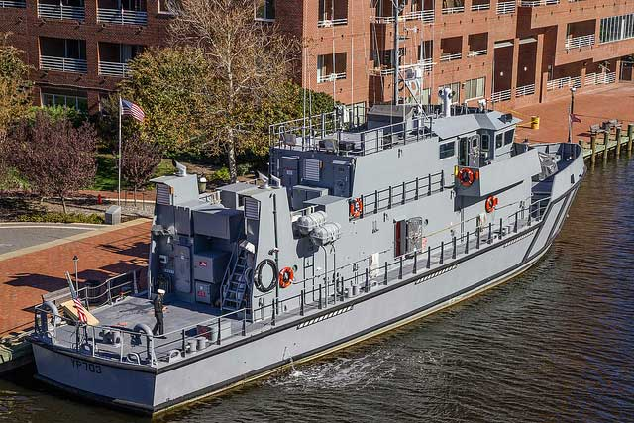
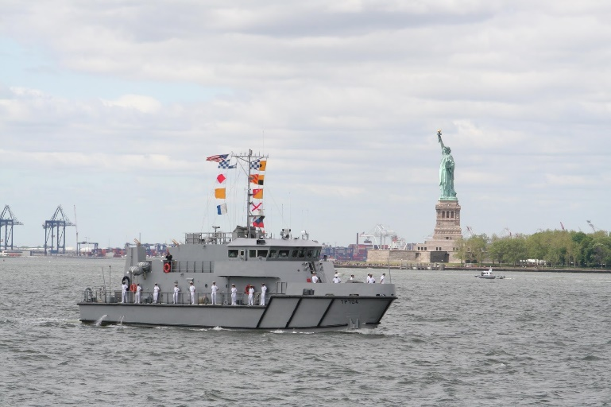
Atlantic Professional Afloat Trng (YPs)
  Train future Navy and Marine Corps officers at sea by enhancing key maritime skills of leadership, seamanship, and navigation. Training includes:
    Team building
    Leadership under pressure
    Sea Survival Training
  Midshipmen will operate in a dynamic maritime environment with realistic underway routines between quality ports of call
  Ports scheduled; Boston, MA, New York City, NY and Cape May, NJ.

Slide 10
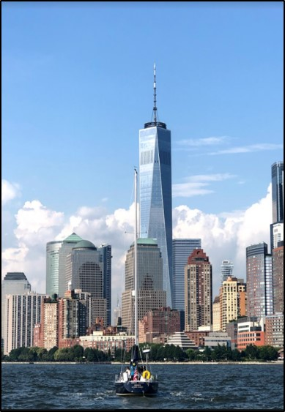
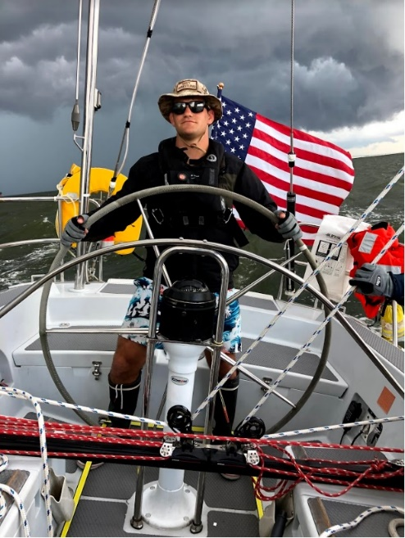
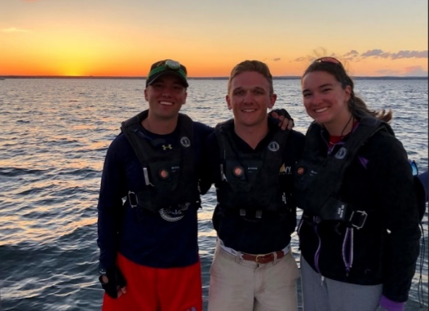
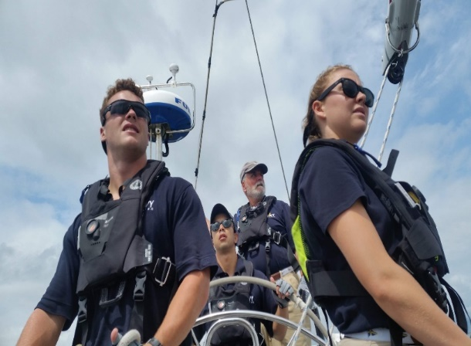
CSTS
  MIDN learn to work in small group leadership roles to crew the Navy ‘44 Training Craft and get offshore sailing experience
  Great experiential leadership opportunities
  Learn to sail for FREE!
  Projected Ports:
  Stamford, CT
  Bristol, RI
  Mystic, CT
  Boston, MA
  Port Washington, NY
  Greenwich, CT

Slide 11
CSTS +
  Block 2 Only
  Opportunity for midshipmen to build upon seamanship, navigation, and leadership lessons learned during their first CSTS cruise and USNA coursework. Midshipmen will serve as watch captains and work towards their XO qualification on Navy 44’ Sail Training Craft.
  Expect 15 days asea, with 4 to 5 days at port visits between USNA and Nova Scotia
  Projected Ports:
  Block Island, RI
  Boston, MA
  Freeport, ME
  Halifax, Nova Scotia

Slide 12
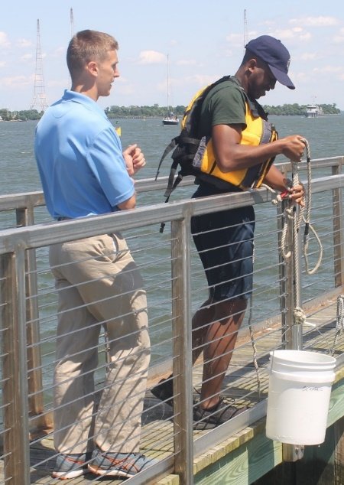
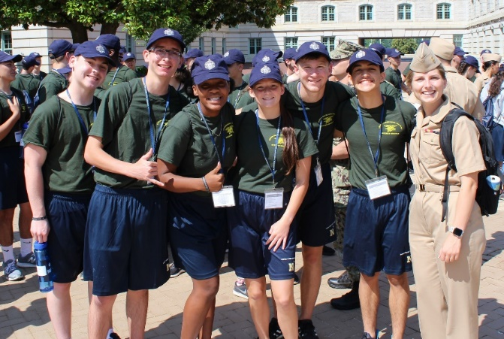
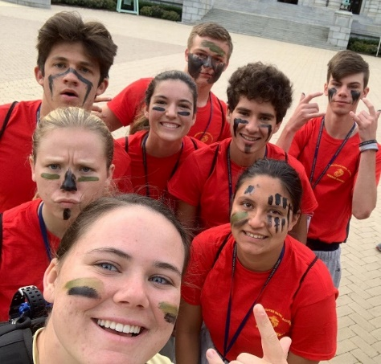
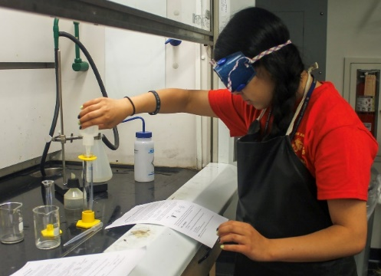
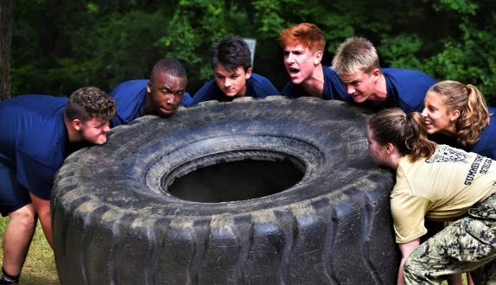
Summer Seminar
  Training Block 1 Billets
    1/C Staff Leadership – 47
    3/C Squad Leaders – 180
  Introduce rising high school seniors to life at USNA
Summer Seminar!

Slide 13
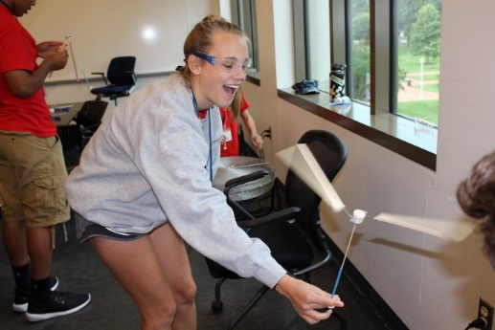
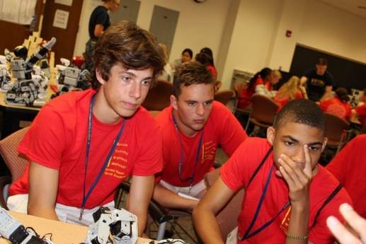
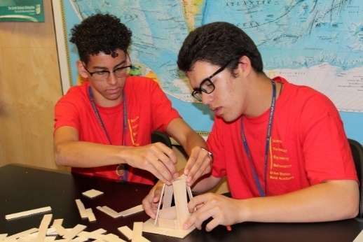
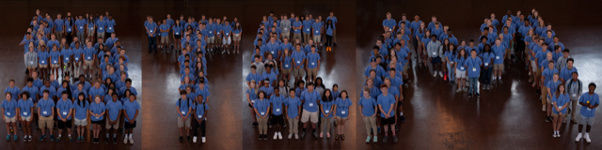
Summer STEM
  Training Block 1 Billets
  1/c Staff Leadership – 37
  3/c Squad Leaders – 101
  Introduce the possibilities of STEM and USNA to rising 9th, 10th and 11th graders
Summer STEM!
Notes:
UPDATE needed

Slide 14
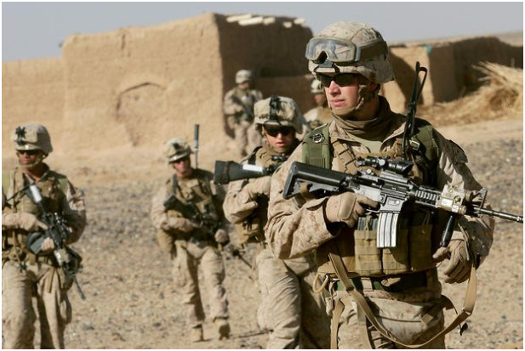
USMC Summer Training
No Prerequisite
  MAGTF East / West
MARSOT Required
  Marine Mountain Warfare Training
  Martial Arts Instructor Course
  Martial Arts Instructor Trainer Course
  Force Fitness Instructor Course
  Army Airborne
  Cadet Field Training
MARSOT Screener on 25 February 2023

Slide 15
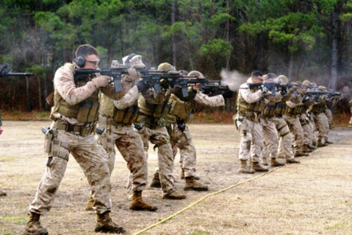
USMC Summer Training
MARSOT and MAT Required
  Marine SECFOR
  MARSOC/Recon
  Marine Corps Instructor Water Safety
  Basic Reconnaissance Primer Course
Marine Advanced Training Screener
4 March 2023

Slide 16
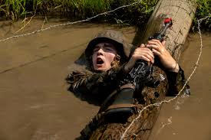
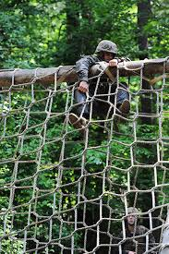
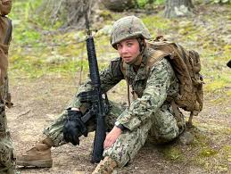
Leatherneck
1/C Requirement for Marine Corps Selection, but anyone can attend. You will be a better Naval Officer as a result.
Common Evolutions
  PFT/O-Course/E-Course
  Land Navigation
  Field Exercises
  Demolition Range
  Leadership Reaction Course (LRC)
  Confidence Course
  Tarzan Course
  Combat Course
  Leadership Evaluation

Slide 17
Internships
  Every internship must be sponsored by a USNA faculty member and approved by the Superintendent’s Review Panel. Only one internship per MIDN per summer is authorized.
  The above guidance applies even if the internship will be executed in lieu of leave and/or at a midshipman's expense. Midshipmen may not arrange internships outside of the formal USNA approval process – this includes with your Congressman. Any questions: Contact Prof Shade, Internship Program Coordinator,
  Review the list of 2024 internships. Contact the faculty POCs for details on eligibility criteria, available projects, and funding. Maintain communication with the faculty internship POC concerning your summer plans.
  You must possess a personal credit card to participate in a funded internship. Travel will be on orders. Reimbursement is through DTS.
  Lodging for local, commutable internships will reside in Bancroft Hall. Consult the Internship Business Rules for more information.
  Independent travel to/from internships is NOT authorized.
Notes:
‹#›
Note 1: internships are not permitted at federal and state legislative offices, nor at foreign embassies.
Note 2: Midshipmen are prohibited by law from accepting financial stipends offered by internship hosts. Reimbursement is via official travel orders or approved Gifts of Travel.
Note 3: Anything other than R&R during leave must be approved by USNA.

Slide 18
Medical Screening
  Required
    Aviation / Submarine / OCONUS / Spec War Cruises
    PROTRAMID
    Outdoor Leadership Training/ Northern Tier/Philmont
    Leatherneck/RECON/MARSOC/MAGTF/MCIWS/RTAP/MTX
    EOD/SEAL PTE
  During the two weeks after Spring Break
    Class Training Officer or PTE Manager will be in contact following Spring Break with more info
  Medical Forms:
    Summer Training Medical Forms (Summer Training INTRANET site)
  PRK
    Recovery timeline works with training
    Approval required from Optometry for certain cruise/PTE
Notes:
Medical screening with the Flight Surgeon/Medical Staff during set medical screening dates for two weeks following Spring Break.
Don’t attempt to set up your own appointment, you must get the screening done during allotted group appointment time.
You are responsible for maintaining a copy of your own up chit, and giving one to the Training Department

Slide 19
Aviation Physiology
  Required for Aviation Fleet Cruises & PROTRAMID
    NOT Aviation Internships or SWO(N) Cruises
  Dates:
    23Mar & 06Apr: Pre-Brief & Academic Lecture at USNA
    08Apr - 02May: Training at NAS Patuxent River, MD
    Backup Date: 20MAY
  Prior to attending training at Pax River, you must:
    Complete the classroom pre-training at USNA
    Receive a signed “Up-Chit” from Medical
    Sign up for an Av Phys date via MIDS
    Not medicate in the 24 hours prior to training (includes prescription and OTC)
  Details/direction to follow from the Training Department
Notes:
-Can’t fly without an Up Chit and Certificate of Completion for AvPhys. Will be obtained at the Medical Screening just discussed.
-NKO initial password set up take over 24 hours (don’t wait until the night before)
-If you want/plan on flying this summer, PRK surgery in the spring will prohibit you from completing the up-chit process and therefore the AvPhys
--will sign up via MIDS
Detailed information on the Aviation Physiology will be passed via e-mail.
Completed requirements in that order. Make a few copies of your up-chit.
You will take the signed up chit with you to Pax River.
Make copies of AvPhys completion paperwork.
Take signed up-chit and AvPhys paperwork with you on Aviation cruise.

Slide 20
Summer Training
Assignments

Slide 21
MIDS Preference Module
  We review every preference and comment for your class
  Clear and concise comments
    Fleet Cruises: block/platform/location
    PTEs: block/event/location (we receive this from the PTE Managers but helps to identify any admin mistakes)
    Compelling leave requests: dates/reason/location
    Summer School/NAAA (again helps identifying any oversights)
3/C Selections |  | 2/C Selections |  | 1/C Selections
Fleet | PTE | Fleet | PTE | Fleet | PTE
PROTRAMID | YPs | Surface | YPs | Surface | YPs
 | CSTS | Surface (N) | CSTS | Surface (N) | CSTS
 | MAGTF | Sub | MAGTF | Sub | MAGTF
 | USMC PTE | Leatherneck* | USMC PTE | Aviation | USMC PTE
 | STEM |  |  | Leatherneck | STEM
 | Sum. Seminar |  |  | Powered Flight | Sum. Seminar
 |  |  |  | IWC
 |  |  |  | RL (CEC, EDO)
Notes:
29

Slide 22
PTE Supplemental Survey
  Required Survey to better delineate PTE preferences
  List up to Six (6) PTEs that you have applied for and the order of preference should you be accepted to all
    Preference helps our office make decisions when selected for multiple PTEs in order to place:
“Right MIDN for the Right Training the First Time”
    Helps PTE Managers manage rosters and alternate lists
  Every Change to your schedule in MIDS affects ~3 other MIDN schedules
KNOW YOUR REQUIREMENTS
KNOW YOUR PREFERENCES
KNOW YOUR SCHEDULE

Slide 23
Good Comments
  Be as detailed as possible
  Comment Block should look like this:
My preferences are as follows:
    Block 3: Leave
    Block 2: Aviation Cruise
    Block 1: Internship
Also applying for Philmont & RTAP, in order of preference
My highest priority is for Block 3 leave for my sister’s wedding on 01Aug in San Diego.
I did not complete a 2/C Cruise. I would like a West Coast Aviation cruise. If not that than East Coast and if not selected for Aviation cruise a DDG on the West Coast.
Notes:
29

Slide 24
Poor Comments
I will be participating in a computer science internship near my parents’ house from 30 May – 20 June.
    All internships must be USNA approved and are assigned via respective Departments and sent to us.
I have already paid for a beach vacation from 22 June – 08 July.
    Training will consider leave requests, but paying for a trip without approved leave is not recommended
    Always buy refundable tickets, rooms, etc.
Because I have leave planned for Hawaii during Block 2, I must do a DDG cruise out of Hawaii during Block 3.
    Be realistic and flexible.
Notes:
29

Slide 25
Priority for Assignments
MSS, Plebe Detail, NASS, YPs, CSTS, and STEM
All are must fill PTEs
By-name requests from Program Managers
Internships, IPO programs, AT/FP, SHAPE, NOLS, etc
Overall Order of Merit & MIDN Preferences
Fleet Cruise, 1st PTE, and Leave for all MIDN
Then 2nd and 3rd PTEs
Notes:
22
We do our best to get every MIDN their #1 choice.

Slide 26
Travel
  Standard Travel: Government provided to AND from training
  For OCONUS Cruises
    MIDN must have a valid (not expire within 6 months) passport in MIDS
    Complete all necessary Trainings, Forms, and Medical Screenings prior to departure
    Details/direction to follow from the Training Department
  Independent Travel: Self arranged to and/or from (more on this later)
  Fleet Cruises are on operational units which can change often (MIDN OPS is not the ships main priority)
  ALL MIDN ON DTS ORDERS MUST A SUBMIT VOUCHER IN PERSON UPON TRAINING COMPLETION OR FACE CONDUCT ACTION
    Expect to submit a voucher (even $0 orders). If a voucher is not required, you will be notified by the Summer Travel / Training Office ahead of time
    Will NOT be conducted virtually & do not try to attempt by yourself
Notes:
‹#›
Fleet Cruises and USNA funded events use Standard Travel unless Independent Travel is authorized and requested

Slide 27

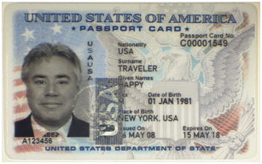

Passports
  Will have the opportunity for OCONUS Fleet Cruises
  Eligibility Requirement:
    Valid US TOURIST PASSPORT with an expiration of 6 months past the return date of your cruise
      Block 3: 15FEB2025
    Passport info MUST be entered into MIDS under TOURIST PASSPORT
Notes:
‹#›
Fleet Cruises and USNA funded events use Standard Travel unless Independent Travel is authorized and requested

Slide 28
Passports - MIDS
  Passport Links:
    Need a Passport
    Renew your Passport
  Current passport processing times are 6-9 weeks, but can be up to 14 weeks
    14 weeks prior to 15MAY (Block 0 start) is 06FEB2023
    Unless you want to pay $60 extra for rush/expedited processing
  Once you have your passport in hand: Enter it into MIDS
    MIDSHIPMAN
    PERSONAL INFORMATION - MAINTAIN
    Fill out TOURIST passport number and expiration date
  Do not enter the info into the OFFICIAL PASSPORT Section with your BLUE passport information
Notes:
‹#›
Fleet Cruises and USNA funded events use Standard Travel unless Independent Travel is authorized and requested

Slide 29
Independent Travel

Slide 30
Independent Travel
  Independent Travel Basics:
    You arrange transportation for (to cruise/from cruise/both) your Fleet Cruise.
    You will be reimbursed up to what it would have cost the government to transport you from USNA to the cruise location
    USNA Ground Transportation (Bus or Duty Van) is $0.00, so no reimbursement
    Use the GSA City Fare calculator to determine reimbursement
      https://www.gsa.gov/plan-book/transportation-airfare-pov-etc/airfare-rates-city-pair-program
  Definitions:
    Eligible - Your general schedule meets the requirements for IT and you will receive the follow-on survey ~2 weeks before your training event
    Approved - Your specific training event details (ie. Cruise location, timeline) meet the requirements, your travel plans have been vetted, and you have received an email saying you are APPROVED to conduct Independent Travel

Slide 31
Independent Travel
  Independent Travel Schedule:
  APR 05: Initial Survey Opens
  APR 08: Initial Survey Closes
      If you do not fill out the Initial Survey, you will NOT be eligible for IT regardless of your circumstance
  MAY 01: Summer Training releases list of ALL Midn eligible for Independent Travel
  ~ 2 Weeks Before Cruise: Follow on survey is sent to any eligible MIDN for that Cruise Block to confirm travel details based on cruise location (open for 48hrs)
      Usually sent once Hull Number is populated in MIDS
  ~ 1 Week Before Cruise: List of Approved or Disapproved MIDN sent out

Slide 32
Independent Travel Eligibility
  MIDN on the following Summer Training evolutions are eligible for Independent Travel to/from Leave:
    Aviation Cruise
    Surface Cruise
    Submarine Cruise
    EOD Cruise
    SEAL Cruise / SOAS
    CEC Cruise
    Leatherneck
    NAPS Detail
    MIDN on the following cruises are NOT authorized Independent Travel:
    OCONUS Fleet Cruises
    All other PTEs*
*PTE Managers may allow IT after discussion with our office. Will be a SEPARATE Process individual to the PTE

Slide 33
Travel Questions
  Purchase refundable tickets that depart at least 24 hours after the end of your cruise. This gives buffer for changes in transportation and to complete your voucher.
  Fleet cruise embark dates and ports change often!
  “Change flight fees” are not reimbursable on your travel claim.
  Go through your Company Officer/SEL for questions after this brief
  Any reduction in training dates will NOT result in independent travel to Leave. All MIDN will return to USNA upon conclusion of training.
COMDTMIDNNOTE 1530 on the Summer Training website:
https://www.usna.edu/Training/

Slide 34
Communication
  Contact your CO/SEL with questions
  CO/SEL will
    Answer your question
    Contact the Training Department
    Present exceptional cases
    Approve Leave OUTSIDE of Scheduled Training
  Timeliness and full disclosure are best practices
  Maintain up to date contact info in MIDS – expect your Fleet Cruise will change at some point
‹#›

Slide 35
Contingencies
  Special Request Chits
    Chits need to be submitted in a timely manner
    Chits need to be routed thru SEL, CO, BATTO, Class Training Officer, Major Crabbe (Deputy Training Officer), CAPT Densham (Training Officer), and CAPT Johns (PRODEV)
    Chits for weddings, reunions, etc during training events need to be routed well in advance of training event (typically 1-2 months prior)
  Medical Status Changes
    You must notify Brigade Medical and the Training Department ASAP
    The Medical Excusal Recommendation form is on the Summer Training intranet site. Requires Brigade Medical Officer, CO/SEL, and Summer Training Duty Officer signatures
  Emergency Leave
    Immediate family member (father, mother, brother, sister, loco parentis)
    Dying, death, accident, or serious illness
    AMCROSS – Ship/Sub/MLO/Program Manager will contact STDO
    If not immediate family and still desiring leave, contact your local (ship/sub) training officer or Program Manager
Notes:
Special request chits may be submitted anytime you think you have a compelling reason for an exception to policy. An example would be that your sister/brother is getting married in Jacksonville the weekend your Surface Cruise ends in Mayport and your leave begins in Jacksonville. This would be a compelling reason to request Independent Travel when it’s not normally authorized.
Loco parentis is defined as a person who stood in place of a parent to the service member 24 hours a day for a period of at least 5 years before the service member became 21 years old or entered military service.

Slide 36
Personal Preparation
  Maintain updated contact and passport info in MIDS
  Review your assignments weekly beginning after Spring Break
  Attend any pre-training events
  Get the gouge from other MIDN who have done that training event
  Assemble your gear in April (use packing list on summer training intranet site)
  Purchase refundable tickets, etc. for leave
  Check email/MIDS daily beginning in May
  DO NOT get locked out of email during summer
Notes:
‹#›

Slide 37
Summer Training Intranet Site
Summer Training Website
  One stop shop:
    This brief
    Key dates
    Current Instructions, Notices, and Manuals
    Summer Training Preference Module guidance
    Special Request Chits / Routing Matrix
    Packing Lists
    Travel guidance
    Medical forms
    Contact Information

Slide 38
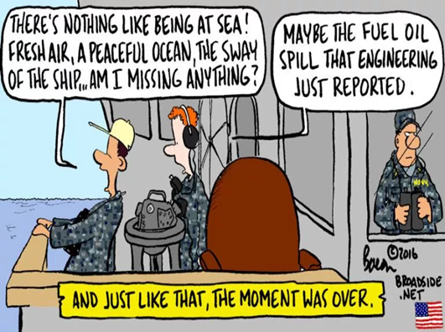

Questions?
Get smart on Summer Training opportunities and identify critical family events this summer
Submit your preferences w/ good comments
Don’t set up your own training event
Utilize your chain of command (MIDN, SEL, CO) before contacting the Training Dept
Complete OCONUS NKO training
Get a tourist passport
Update contact and passport info in MIDS
Schedule and go to your medical screening and Av/Phys
Complete your personal preps in April
‹#›
Notes:
‹#›

Slide 39
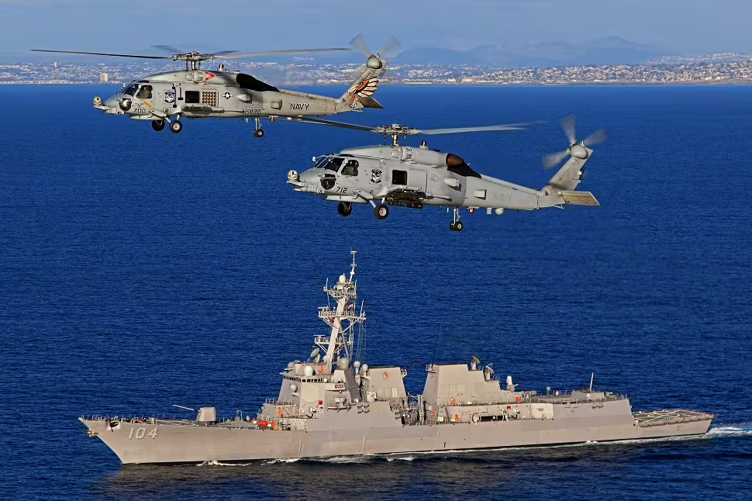
The Most Important Question
How can YOU best set yourself up for
Community Assignment & your Naval career?

