Slide 1
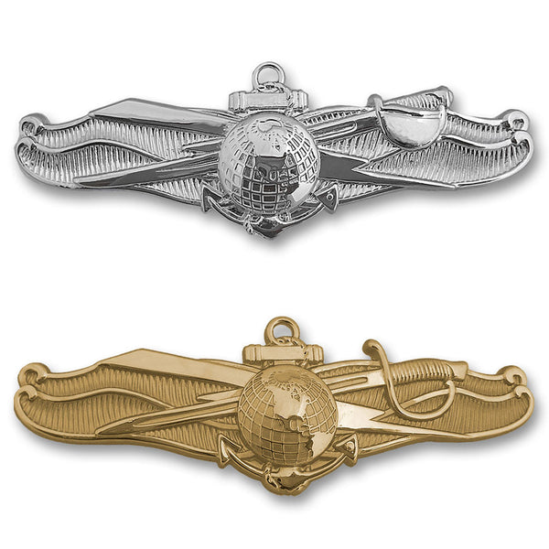
IWC MQS
Notes:
Img source: https://www.google.com/url?sa=i&url=https%3A%2F%2Fwww.usamm.com%2Fproducts%2Finformation-dominance-warfare-insignia&psig=AOvVaw2h-TmWZxvwi34rHLqxVTMu&ust=1677595037341000&source=images&cd=vfe&ved=0CA8QjRxqFwoTCJC2m9T2tf0CFQAAAAAdAAAAABAJ

Slide 2

Defense Information Systems Agency
Service Provider for the DoD
DoDs version of Comcast/Verizon/Spectrum etc.
Voice/video
Network/satellite/transport
VPN/security
Notes:
Img source: https://disa.mil/

Slide 3
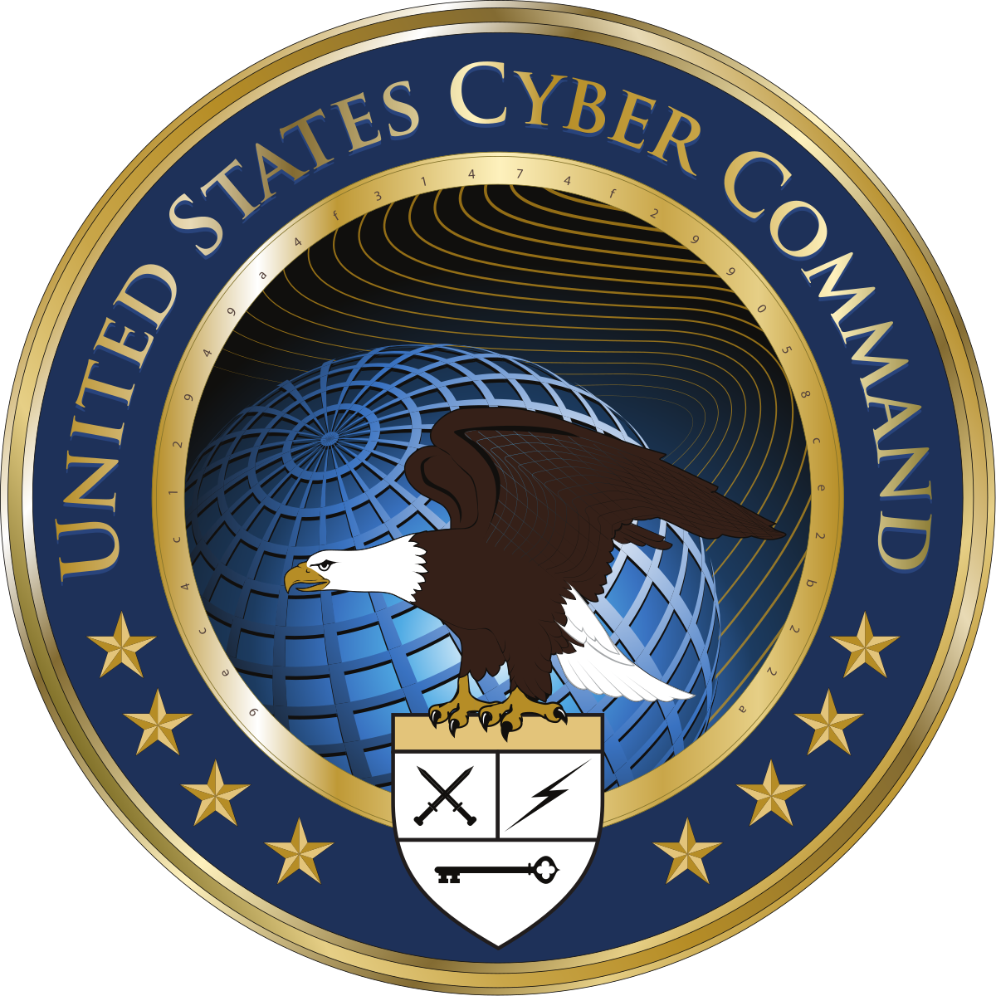
USCYBERCOM (USCC)
Direct, Synchronize, and Coordinate Cyberspace Planning and Operations - to Defend and Advance National Interests - in Collaboration with Domestic and International Partners
Three focus areas:
  Defend the DODIN
  Support to COCOMs
  Defend the nation
Notes:
Img source: https://www.google.com/url?sa=i&url=https%3A%2F%2Fen.wikipedia.org%2Fwiki%2FUnited_States_Cyber_Command&psig=AOvVaw312mT9R0ZLypscKgBvNsqi&ust=1677595281517000&source=images&cd=vfe&ved=0CA8QjRxqFwoTCJCs18z3tf0CFQAAAAAdAAAAABAD
Other sources:
https://www.cybercom.mil/About/Mission-and-Vision/

Slide 4
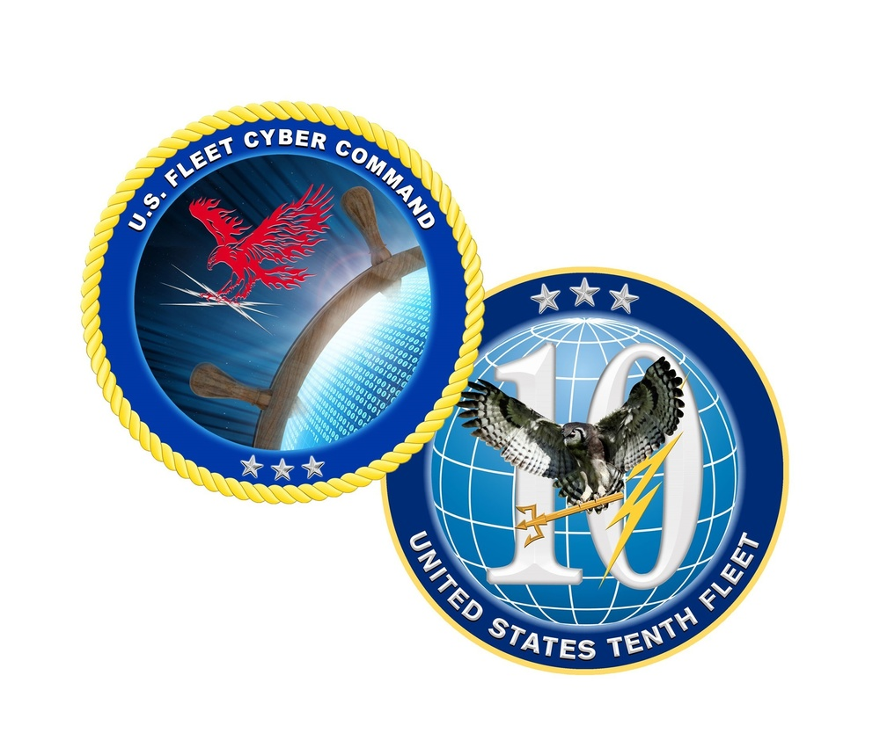
USFLTCYBERCOM (FCC)
Reports to the CNO
US 10th Fleet is the operational arm of FCC
Responsible for:
  Cyberspace operations (offensive/defensive)
  Information operations
  Space operations
  Signals intelligence
Notes:
Img source: https://www.google.com/url?sa=i&url=https%3A%2F%2Fwww.dvidshub.net%2Fnews%2F281399%2Fus-fleet-cyber-command-10th-fleet-holds-change-command&psig=AOvVaw2IcHOSDKBVJWMHhQmgWPB-&ust=1677612734583000&source=images&cd=vfe&ved=0CA8QjRxqFwoTCODenc24tv0CFQAAAAAdAAAAABAD
Other sources:
https://www.fcc.navy.mil/

Slide 5
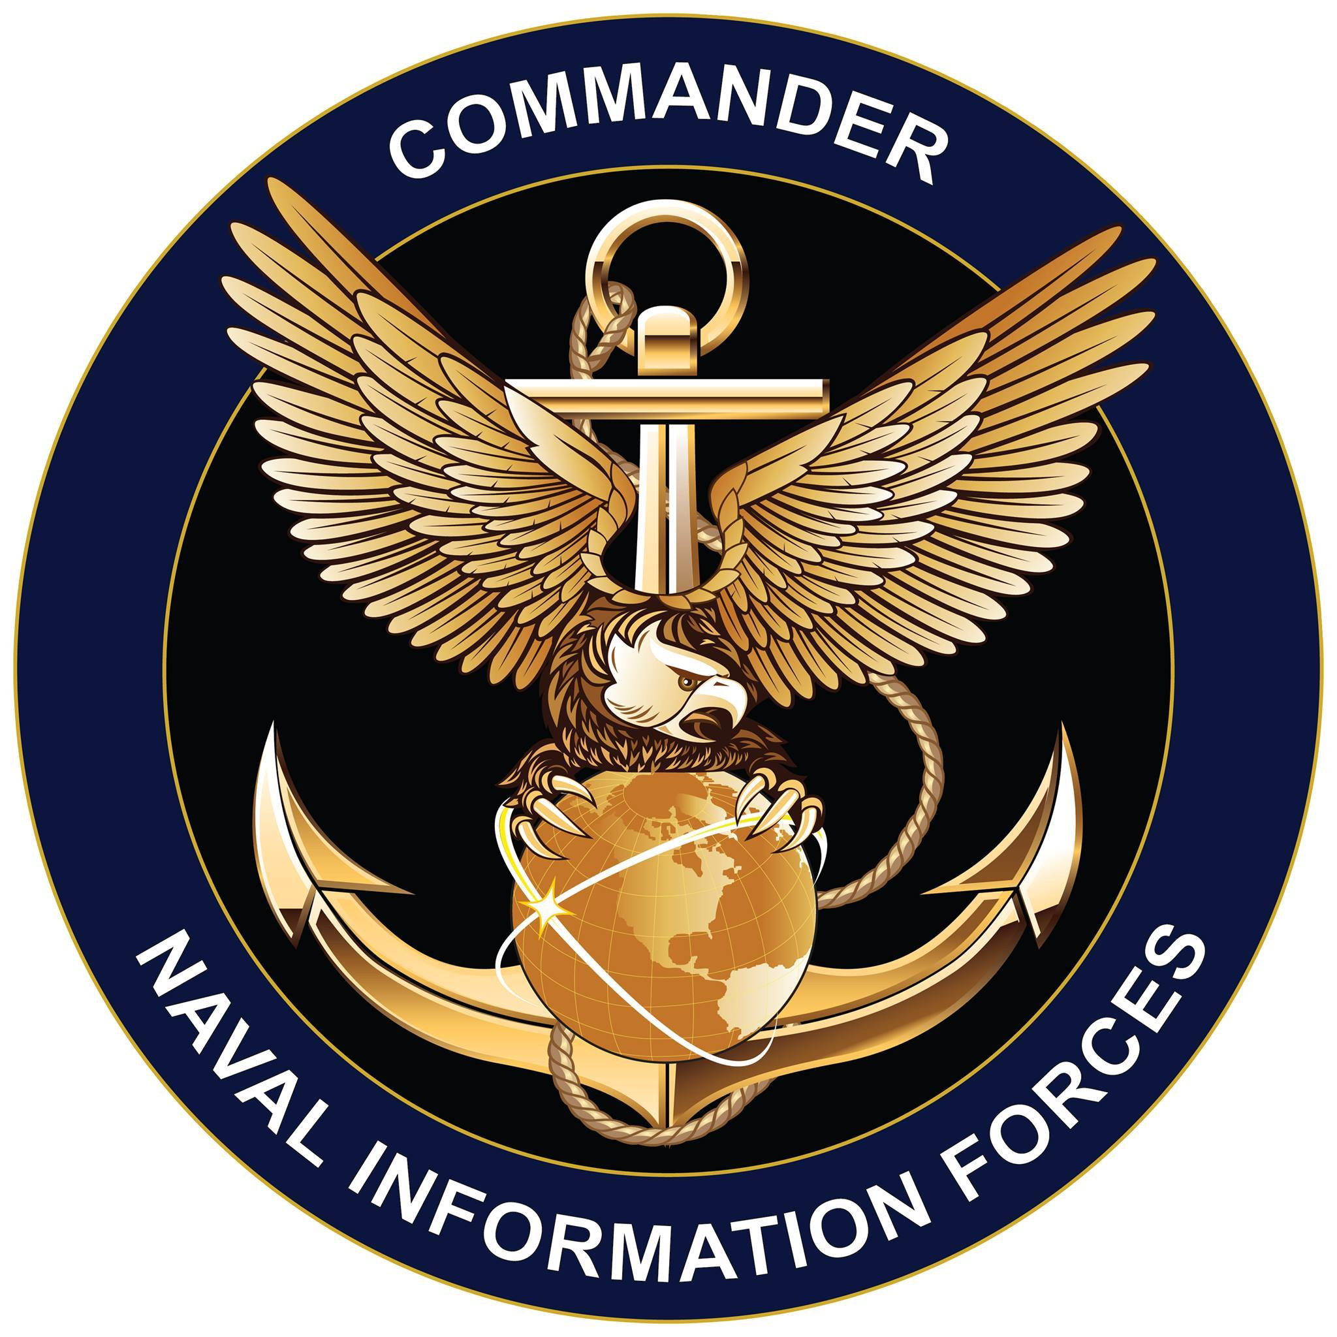
Naval Information Forces (NAVIFOR)
TYCOM for FCC
Commander, Naval Information Forces (NAVIFOR) generates, directly and through our leadership of the IW enterprise, agile and technically superior manned, trained, equipped and certified combat-ready IW forces to ensure our Navy will decisively deter, compete and win.
Notes:
Img source: https://www.google.com/url?sa=i&url=https%3A%2F%2Fen.wikipedia.org%2Fwiki%2FU.S._Naval_Information_Forces&psig=AOvVaw0OIXNqN3F9FcrVXxjT6VX5&ust=1677598733263000&source=images&cd=vfe&ved=0CA8QjRxqFwoTCLDsk7iEtv0CFQAAAAAdAAAAABAD
Other sources:
https://www.navifor.usff.navy.mil/About-Us/Mission/

Slide 6
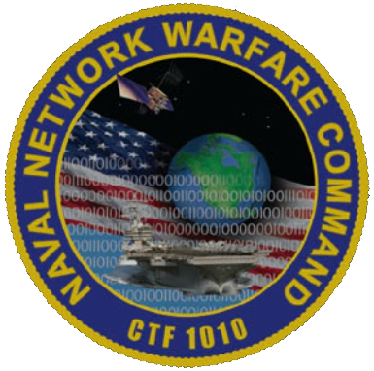
Naval Network Warfare
Command (NNWC)
Executes tactical-level command and control to direct, operate, maintain and secure Navy communications and network systems for Department of Defense (DoD) information networks, and leverages joint space capabilities for Navy and joint operations.
Responsible for Navy’s portion of the DoDIN (DoDIN-N)
Navy - Marine Corps Intranet (NMCI)
Navy Blue Team
Notes:
Img source: https://www.navifor.usff.navy.mil/navnetwarcom/
Other sources: https://www.navifor.usff.navy.mil/navnetwarcom/

Slide 7
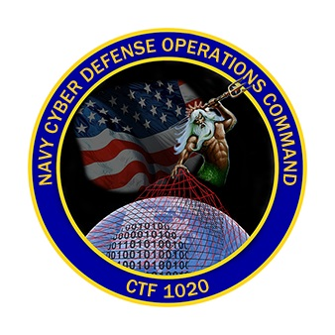
Navy Cyber Defense Operations
Command (NCDOC)
The mission of Navy Cyber Defense Operations Command (NCDOC) is to execute defensive cyberspace operations and enable global power projection through proactive network defense.
The Navy’s Security Operations Center (SOC).
Notes:
Img source: https://wjm.s3.amazonaws.com/clearedjobs/uploads/NCDOC.jpg
Sources: https://www.navifor.usff.navy.mil/Organization/Operational-Support/NCDOC/About-Us/Mission-Vision-and-Values/

Slide 8
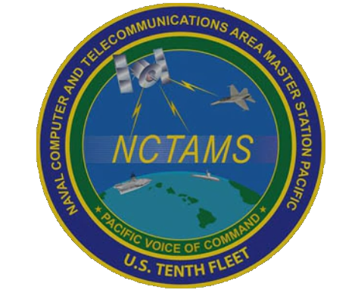
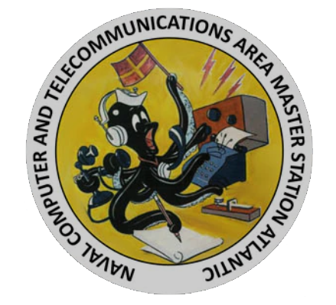
Naval Computer and Telecommunications Area Master Station (NCTAMS)
Provide Command and Control (C2) for the fleet.
Ground stations for satellite communications (SATCOM)
shipboard networks (IT-21)
Voice circuits
Message center
Notes:
Sources: https://www.navifor.usff.navy.mil/Organization/Operational-Support/NCTAMS-LANT/About-Us/Mission-and-Vision/
https://www.navifor.usff.navy.mil/Organization/Operational-Support/NCTAMS-PAC/About-Us/Mission-and-Vision/

Slide 9
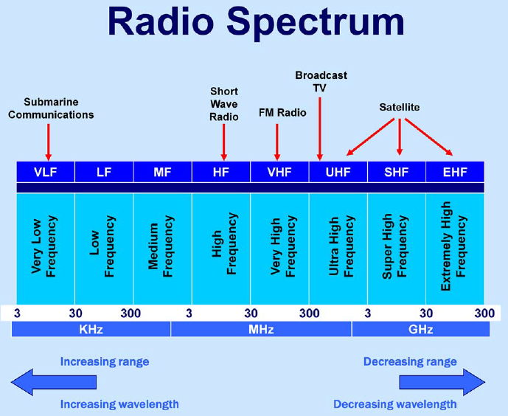
Radio Frequency (RF) Communications
Communication between two or more points using
electromagnetic waves as the transmission medium
Ship-to-ship, ship-to-shore, broadcast
Througouht the electromagnetic spectrum:
  HF, VHF, UHF, SHF, EHF
Line-of-Sight (LoS) and Beyond-Line-of-Sight (BLoS)
Characteristics and capabilities vary widely across the spectrum and performances are highly dependent on atmospheric conditions (METOC helps here!)
Notes:
HF – High Frequency
VHF – Very High Frequency
UHF – Ultra High Frequency
SHF – Super High Frequency
EHF – Extremely High Frequency

Slide 10
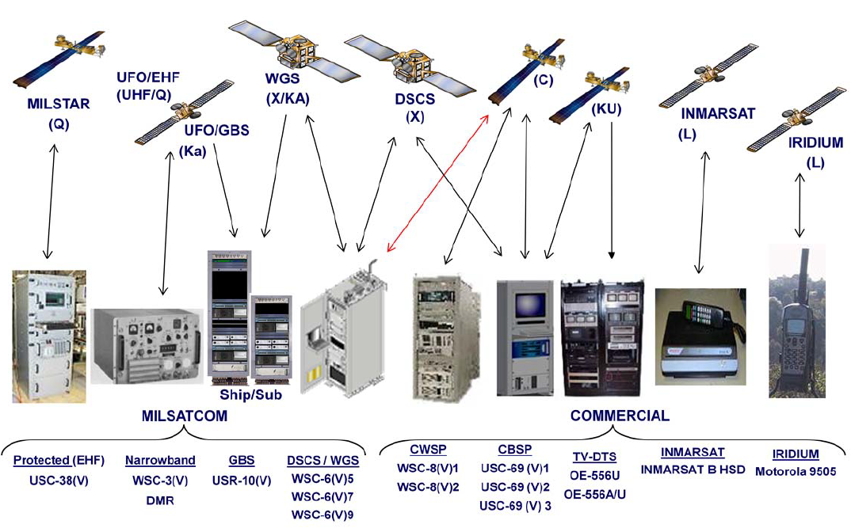
Satellite Communications (SATCOM)
The use of artificial satellites to provide RF
communication between various points on Earth
Voice and Data
Upper portions of the electromagnetic spectrum
  UHF, SHF, EHF
Beyond Line of Sight (BLoS)
SATCOM is highly dependent on atmospheric conditions
Generally, higher frequencies in the spectrum provide greater data throughput

Slide 11
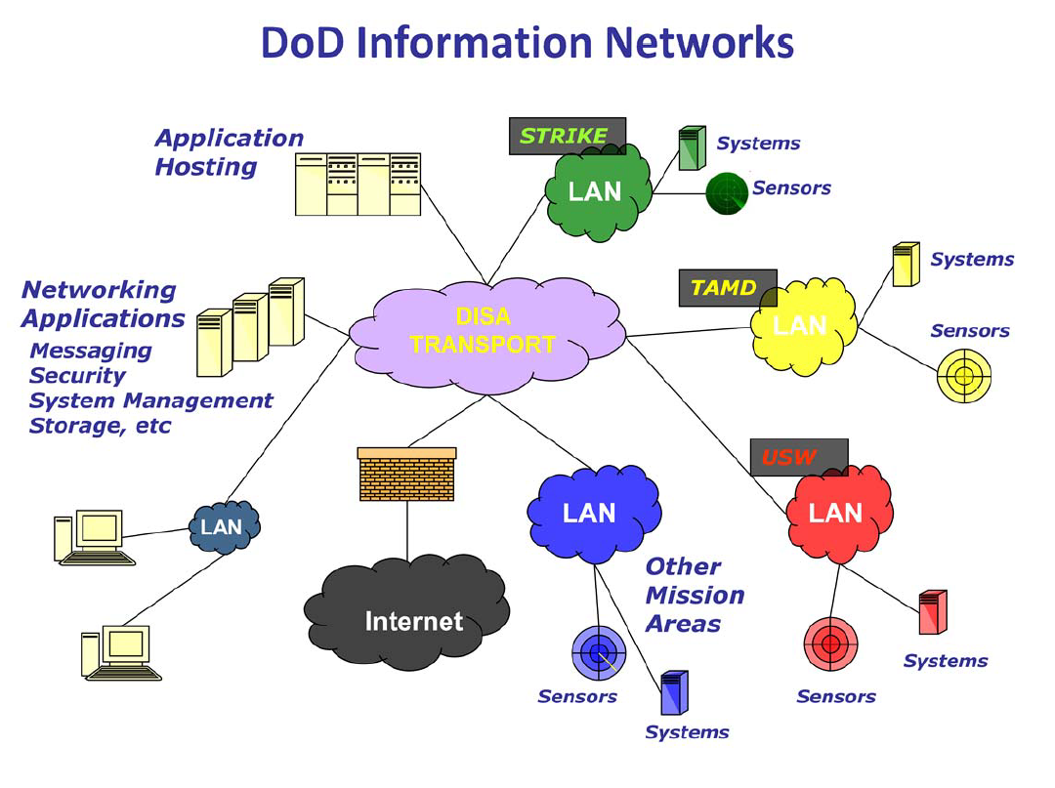
Terrestrial Network Infrastructure
DoD Information Networks (DoDIN) - a globally interconnected
end-to-end set of information capabilities for collecting, processing,
storing, disseminating and managing information on demand to
warfighters, policymakers and support personnel
The Navy’s Internet
Network Operation Centers provide network capabilities globally to all commands in support of the Navy’s classified and unclassified missions.
  Norfolk, Hawaii, Italy, Bahrain
Teleport sites connect tactical units to shoreside infrastructure via SATCOM links.

Slide 12
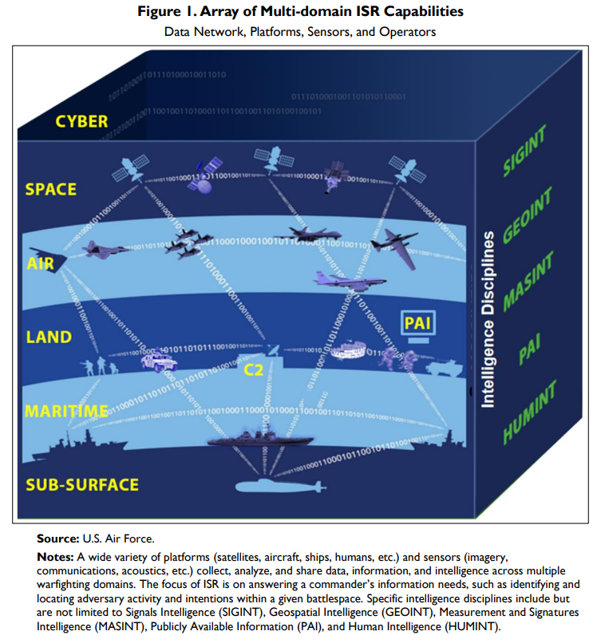
What does Collection Look Like?
Notes:
PAI: publicly available information-OSINT

Slide 13
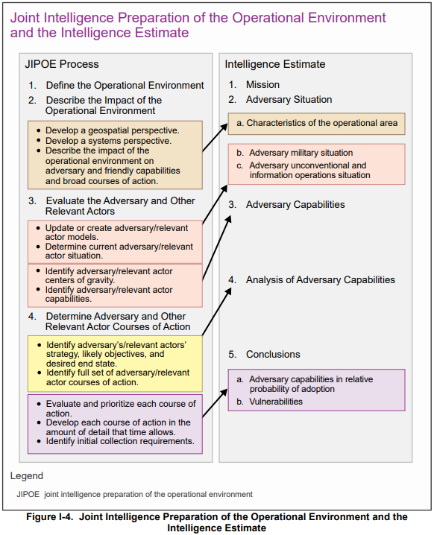
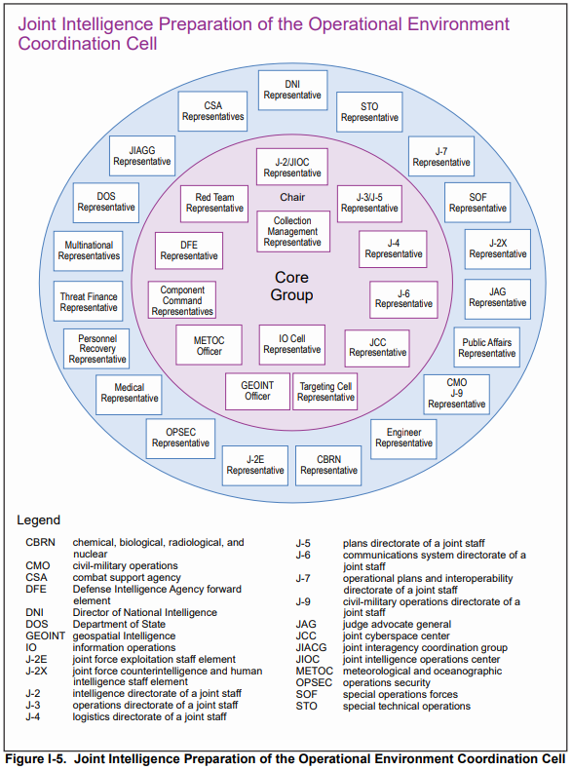
Joint Intelligence Preparation of the Operational Environment (JIPOE)
Notes:
Intel officers will spend weeks at NIOBC doing JIPOE.
JIPOE is a dynamic process that both supports and is supported by each of the categories of intelligence operations that comprise the intelligence process
JIPOE and (Intelligence Preparation of the BattleField) IPB products generally differ in purpose, focus, and level of detail.
The purpose of JIPOE is to support the JFC by determining the probable intent and most likely COA for the adversary and other relevant actors throughout the OE
IPB is specifically designed to support the individual operations of the component commands.

