Slide 1
NS433 - 04: Naval Aviation Squadron Organization

Slide 2
Learning Objectives
Focus: The instructor will introduce the typical departmental organization and the roles and responsibilities of the different positions found in Naval Aviation squadrons.
Discuss the roles and responsibilities of the squadron front office.
Explain the roles and responsibilities of the five departments found in a squadron.
Know the departmental roles that Junior Officers will hold within the departments.

Slide 3
Squadron Organization
CO
CMC
XO
DH
OPSO
MO
TRAINO
ADMINO
SAFETYO
MMC
Non-Aviator or Non-First Tour JO
AMO
IntelO
TacticsO
MCO
MMCO
1st Tier
AOPS
QAO
Pilot NATOPS
NFO NATOPS
2nd Tier
Readiness Officer
AV/ARM DIVO
Aircraft DIVO
Line DIVO
Pilot TRAIN
NFO TRAIN
PERSO
3rd Tier
SchedsO
Ground Training
1st LT
PAO
LegalO
Ground Safety

Slide 4
Squadron Organization
Naval Aviation squadrons come in many different shapes depending on community, location, size, etc.
This can possibly affect a squadron’s organization.
Example:
  No Training Department
  Different JO tier levels
  Different JO roles
  Multiple JOs in the same role

Slide 5
“Triad” / “Front Office”
Commanding Officer (CO)
  Responsible for everything within a squadron
  “Skipper” (different from SWO community)
  Runs the Operations side of the squadron (depending on individual squadron nuances)
Executive Officer (XO)
  Skipper’s right hand
  Responsible to the CO; preparing to assume CO responsibilities after change of command
  Runs the Admin side of the squadron (depending on individual squadron nuances)
Command Master Chief (CMC)
  Enlisted advisor to the CO
  Monitor squadron’s organizational health
CO
CMC
XO

Slide 6
Five Squadron Departments
Operations
Maintenance
Training
Admin
Safety
Each department is led by a Department Head, a JO and/or LDO/Warrant Officer, and one or more senior enlisted.

Slide 7
Operations Department
CO
CMC
XO
DH
OPSO
MO
TRAINO
ADMINO
SAFETYO
MMC
Non-Aviator or Non-First Tour JO
AMO
IntelO
TacticsO
MCO
MMCO
1st Tier
AOPS
QAO
Pilot NATOPS
NFO NATOPS
2nd Tier
Readiness Officer
AV/ARM DIVO
Aircraft DIVO
Line DIVO
Pilot ATRAIN
NFO ATRAIN
PERSO
3rd Tier
SchedsO
Ground Training
1st LT
PAO
LegalO
Ground Safety

Slide 8
Operations Department
“Ops”
Mission:
  Creates daily flight schedule, then executes that plan via the SDO
  Creates weekly / monthly plan
  Coordinates with the other departments
  Reports and tracks readiness
  Tracks currency
  Liaison between the Wing and CAG (CVN)

Slide 9
Department Roles
Operations Officer (OPSO): Usually the most senior DH in a squadron
  In some communities, the OPSO must be a Weapons School grad
Intelligence Officer (IntelO):
  Ground officer
  Command Security Manager
Assistant Operations Officer (AOPS):
  Typically a 1st tier JO job
  Assistant to the OPSO
  Makes the monthly / weekly plan
Readiness Officer
  Typically a 2nd tier job
  Tracks and updates readiness condition
Scheduling Officer (SchedsO):
  Typically a new check-in job
  Typically more than one SchedsO
  Takes the weekly plan and turns it into a daily flight schedule

Slide 10
Maintenance Department
CO
CMC
XO
DH
OPSO
MO
TRAINO
ADMINO
SAFETYO
MMC
Non-Aviator or Non-First Tour JO
AMO
IntelO
TacticsO
MCO
MMCO
1st Tier
AOPS
QAO
Pilot NATOPS
NFO NATOPS
2nd Tier
Readiness Officer
AV/ARM DIVO
Aircraft DIVO
Line DIVO
Pilot ATRAIN
NFO ATRAIN
PERSO
3rd Tier
SchedsO
Ground Training
1st LT
PAO
LegalO
Ground Safety

Slide 11
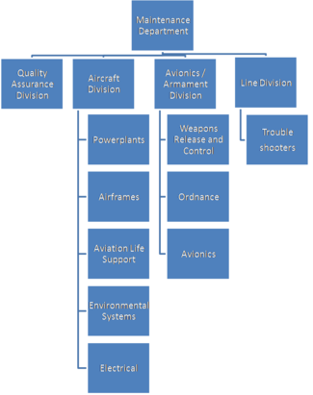
Maintenance Department
Largest department in a squadron.
Each “shop” generally consists of one type of rate (maintenance specialty).
Shops typically have one LPO who answers to an overall division LCPO.
This department is typically where you find LDOs and Warrant Officers in squadrons.

Slide 12
Maintenance Department
Easily the largest department in the squadron
Mission:
  Maintain “Up” (mission-ready) aircraft
  Work with OPS to ensure aircraft availability
  “Material Readiness”
  Runs part of the squadron budget
  Runs numerous maintenance programs

Slide 13
Department Roles
Maintenance Officer (MO): Usually the second most senior DH
Maintenance Master Chief (MMC): The second most senior enlisted
  Squadrons may have only two Master Chiefs in a squadron, CMC and MMC
Assistant Maintenance Officer (AMO): Typically an LDO/Warrant
  Premier ground officer role
  Assists the MO
  Ensures the squadron has the proper manning
Maintenance Control Officer (MCO): Typically an LDO/Warrant
  Runs Maintenance Control to ensure “Up” aircraft
  Responsible for all personnel in Maintenance Control
Maintenance Material Control Officer (MMCO): Typically an LDO/Warrant
  Runs the Maintenance Supply shop to ensure the squadron has all required tools and equipment

Slide 14
Department Roles (cont)
Quality Assurance Officer (QAO):
  1st tier JO job (essentially the “Maintenance Safety Officer)
  Acts as a check to ensure proper maintenance practices are conducted
  Monitors all programs
Avionics and Armaments Division Officer (AV/ARM):
  Runs the AV/ARM Division (Electronics Techs (AT), Electricians (AE), Ordies (AO))
Aircraft Division Officer:
  Runs the Aircraft Division (Power Plants (AD), Framers (AM), and Corrosion Control)
  Possibly may run the PR shop
Line Division Officer:
  Runs the Line Division, typically made up of most junior enlisted personnel awaiting their rating

Slide 15
Training Department
CO
CMC
XO
DH
OPSO
MO
TRAINO
ADMINO
SAFETYO
MMC
Non-Aviator or Non-First Tour JO
AMO
IntelO
TacticsO
MCO
MMCO
1st Tier
AOPS
QAO
Pilot NATOPS
NFO NATOPS
2nd Tier
Readiness Officer
AV/ARM DIVO
Aircraft DIVO
Line DIVO
Pilot ATRAIN
NFO ATRAIN
PERSO
3rd Tier
SchedsO
Ground Training
1st LT
PAO
LegalO
Ground Safety

Slide 16
Training Department
May or may not exist as part of the Operations Department (squadron dependent)
Mission:
  Plan and track pilot, NFO, and aircrew qualifications
  Work with OPS on scheduling training events
  Coordinate weapons ranges and live training events with outside agencies

Slide 17
Department Roles
Training Officer (TrainO): Introductory DH job
Tactics Officer (TacticsO):
  Usually a Super JO or the TRAINO
  Liaison between the squadron and community Weapons School
    Takes tactical publications and implements them into squadron training plans for aircrew qualifications
  Ensures squadron’s tactical proficiency
Pilot/NFO Assistant Training Officer:
  Assists the TRAINO
  Plans and tracks and qualifications
Ground Training Officer:
  Plans and tracks academic training

Slide 18
Admin Department
CO
CMC
XO
DH
OPSO
MO
TRAINO
ADMINO
SAFETYO
MMC
Non-Aviator or Non-First Tour JO
AMO
IntelO
TacticsO
MCO
MMCO
1st Tier
AOPS
QAO
Pilot NATOPS
NFO NATOPS
2nd Tier
Readiness Officer
AV/ARM DIVO
Aircraft DIVO
Line DIVO
Pilot ATRAIN
NFO ATRAIN
PERSO
3rd Tier
SchedsO
Ground Training
1st LT
PAO
LegalO
Ground Safety

Slide 19
Admin Department
Mission:
  Responsible for all squadron administration
  Run the squadron budget
  Assist squadron members with admin issues
  Provides enlisted career counseling
  In charge of squadron correspondence, legal matters, public affairs, spaces, and non-flight related assets

Slide 20
Department Roles
Admin Officer (AdminO): Introductory DH job
Personnel Officer (PERSO):
  Assistant AdminO
  Runs the Admin Shop (YNs, PSs)
Legal Officer (LegalO):
  New guy job after attending a two-week legal officer training course
  Assists the CO in all legal matters; assistant in NJP/Captain’s Mast
1st Lieutenant:
  In charge of squadron building and ship spaces while embarked
  Responsible for MAs and CSs
Public Affairs Officer (PAO):
  In charge of all squadron publicity: Facebook, news article, etc.

Slide 21
Safety Department
CO
CMC
XO
DH
OPSO
MO
TRAINO
ADMINO
SAFETYO
MMC
Non-Aviator or Non-First Tour JO
AMO
IntelO
TacticsO
MCO
MMCO
1st Tier
AOPS
QAO
Pilot NATOPS
NFO NATOPS
2nd Tier
Readiness Officer
AV/ARM DIVO
Aircraft DIVO
Line DIVO
Pilot ATRAIN
NFO ATRAIN
PERSO
3rd Tier
SchedsO
Ground Training
1st LT
PAO
LegalO
Ground Safety

Slide 22
Safety Department
Mission:
  Ensures squadron follows all safety publications
  Ensures squadron adheres to NATOPS requirements
  Tracks and analyzes safety trends and incidents
  Implements the ORM and CRM programs
  In charge of squadron HAZREPS and MISHAPS

Slide 23
Department Roles
Safety Officer: Introductory DH job, requires ASO school
Pilot/NFO NATOPS Officer:
  1st tier JO job
  Plans and tracks all pilot NATOPS requirements
  Assists the SAFETYO (Assistant SAFETY Officer)
  Squadron UNI (conducts NATOPS checks)
Ground Safety Officer (GSO):
  New guy job
  Plans Safety Stand-downs

Slide 24
Enlisted Rates
AD: Aviation Machinist's Mate (Engines and Props)
AE: Aviation Electrician's Mate (Radar, IF systems, Camera Systems, Computers)
AM: Aviation Structural Mechanic (Landing gear, Hydraulic Systems, Control Surfaces)
AO: Aviation Ordnanceman (Airborne Weapons loading, inspection, storage)
AT: Aviation Electronic Technician (Radios, Communications, and Navigation)
AW: Naval Aircrewman (Aircraft operators, often broken down into more specific rates like AWF, AWO, AWV, AWR, AWS)
AZ: Aviation Maintenance Admin (Aircraft maintenance paperwork)
PR/AME: Aircrew Survival Equipmentman (Parachutes, seats and survival/protective gear)
LS: Logistics Specialist (Purchasing and cataloging general supplies)
YN: Yeoman (Admin workers)

Slide 25
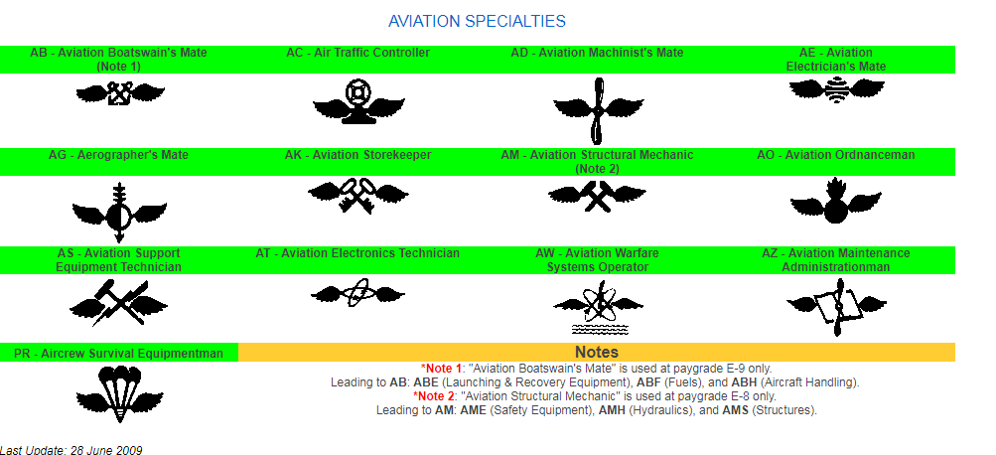
Enlisted Rates

Slide 26
Questions?

